Slide 1

6th Grade Accelerated Math
Unit 5, Lesson 1 What Are Ratios? Volume 1, pg. 173

Slide 2



Benchmark
MA.6.AR.3.1
Given a real-world context, write and interpret ratios to show the relative sizes of two quantities using appropriate notation: $\frac{a}{b}$, $a$ to $b$, or $a:b$ where $b≠0$.
volume 1, pg. 173

Slide 3
Integrated Mathematical Thinking and Reasoning Standards
MA.K12.MTR.7.1 Apply mathematics to real-world contexts.
volume 1, pg. 173

Slide 4

Learning Targets
I can write and interpret ratios.
I can draw a diagram that represents a ratio and explain what the diagram means.
volume 1, pg. 173

Slide 5

Warm-Up
volume 1, pg. 173

Slide 6
5.1.1 Warm-Up: What Kind and How Many?
A set of figures with different colors, shapes, and sizes is shown.
The figures can be sorted using different categories.
volume 1, pg. 173

Slide 7
Complete the table by determining the number of groups for each method of sorting. For the last row, determine a third way the figures could be sorted and how many groups the sorting method would create.
Sorting Method | Number of Groups Created
Sorted by color
Sorted by area
Sorted by _____________
volume 1, pg. 173

Slide 8

Guided Instruction
volume 1, pg. 174

Slide 9
5.1.2 Guided Instruction: Writing and Interpreting Ratios
The figures from the Warm-Up can be described using ratio language.
A ratio is a comparison of two or more quantities.
Complete the statements to describe the relationships between the figures from the Warm-Up.
There are ____ yellow figures for every ____ green figures.
volume 1, pg. 174

Slide 10
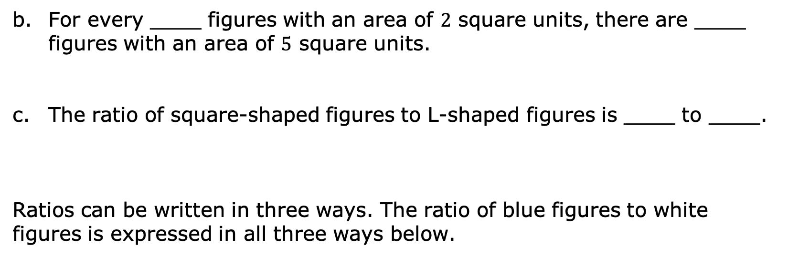
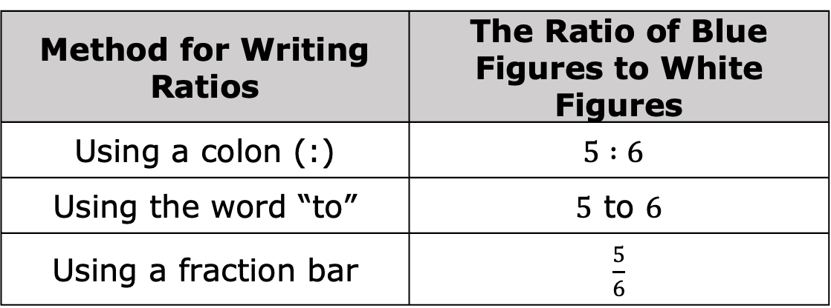
For every ____ figures with an area of $2$ square units, there are ____ figures with an area of $5$ square units.
The ratio of square-shaped figures to L-shaped figures is ____ to ____.
Ratios can be written in three ways. The ratio of blue figures to white figures is expressed in all three ways below.
Method for Writing Ratios | The Ratio of Blue Figures to White Figures
Using a colon (:) | $$5 :6$$
Using the word “to” | $5$ to $6$
Using a fraction bar | $\frac{5}{6}$
volume 1, pg. 174

Slide 11
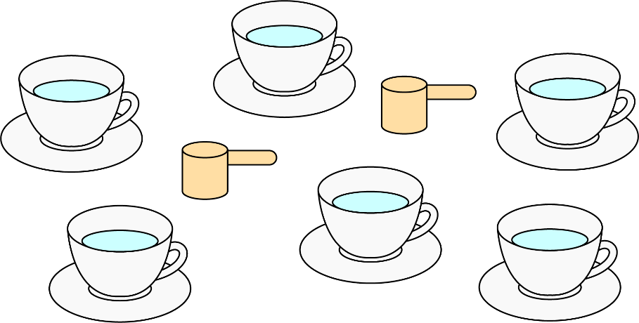
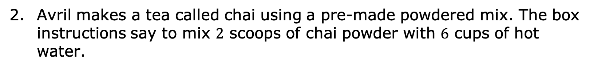
Avril makes a tea called chai using a pre-made powdered mix. The box instructions say to mix $2$ scoops of chai powder with $6$ cups of hot water.
volume 1, pg. 174

Slide 12
Complete each description of the collection by writing a number in each box.
The ratio of chai mix scoops to cups of water is
: .
The ratio of cups of water to chai mix scoops is
____ .
volume 1, pg. 174

Slide 13


The relationship between chai mix and water can also be described using other numbers. Consider the rearranged image.
z
z
Complete the statements.
There are ____ cups of water per scoop of chai mix.
There is ____ scoop of chai mix for every cup of water.
volume 1, pg. 175

Slide 14
The order of the ratio is important, as it relates specifically to the quantities being described. The order used in the written description must match the order of the values that are being compared.
Discuss with your partner why the ratio of chai mix scoops to cups of water is not equivalent to the ratio of cups of water to chai mix scoops.
volume 1, pg. 175

Slide 15

Try It
volume 1, pg. 175

Slide 16
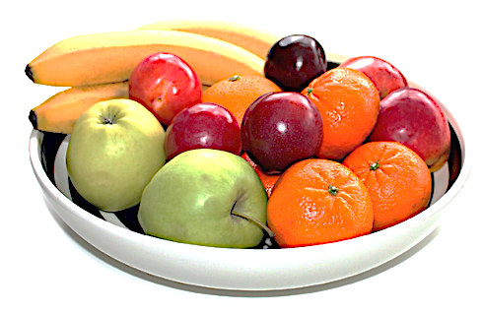
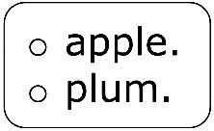
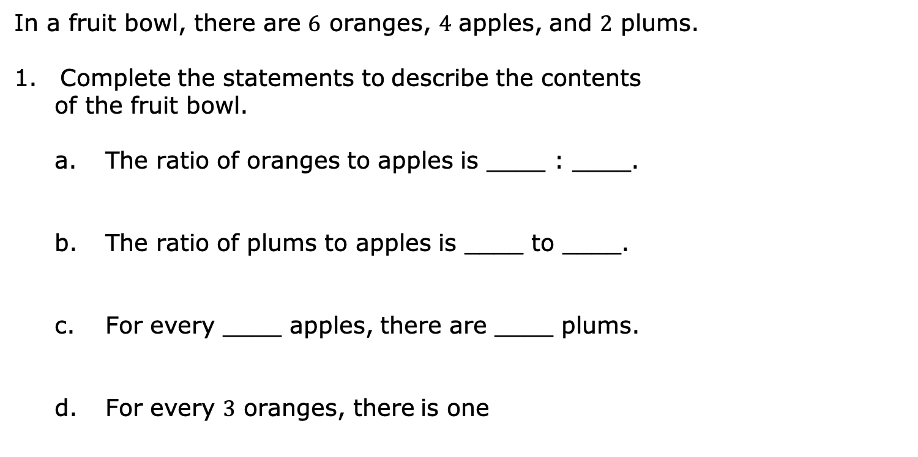
5.1.3 Try It: Writing and Interpreting Ratios
In a fruit bowl, there are $6$ oranges, $4$ apples, and $2$ plums.
Complete the statements to describe the contents
of the fruit bowl.
The ratio of oranges to apples is ____ : ____.
The ratio of plums to apples is ____ to ____.
For every ____ apples, there are ____ plums.
For every $3$ oranges, there is one
volume 1, pg. 175

Slide 17
Explain how you determined the answer for Part d using words or a sketch.
volume 1, pg. 175

Slide 18
Guided Instruction
volume 1, pg. 176

Slide 19

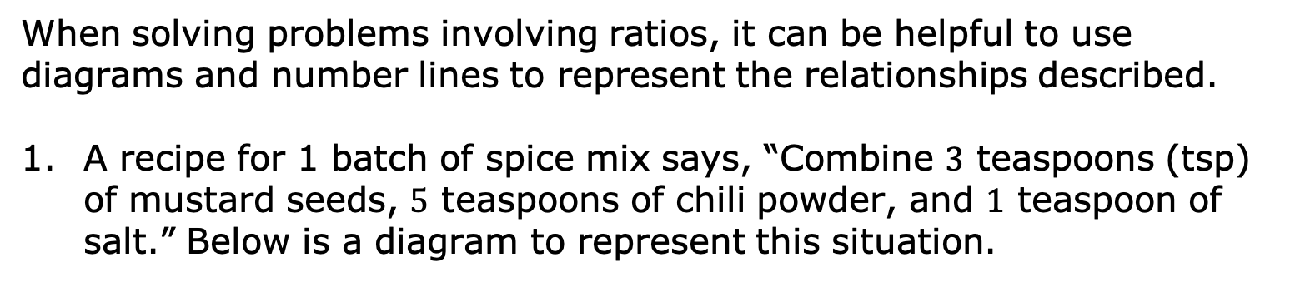
5.1.4 Guided Instruction: Representing Ratios With Diagrams
When solving problems involving ratios, it can be helpful to use diagrams and number lines to represent the relationships described.
A recipe for 1 batch of spice mix says, “Combine $3$ teaspoons (tsp) of mustard seeds, $5$ teaspoons of chili powder, and $1$ teaspoon of salt.” Below is a diagram to represent this situation.
mustard seeds (tsp)
chili powder (tsp)
salt (tsp)
How many teaspoons of spices are in 1 batch of the mix?
volume 1, pg. 176

Slide 20
Ratios can be used to describe part-to-part relationships, where one part is being compared to another, and part-to-whole relationships, where one part is being compared to the entire group.
Complete the statements in the table.
Type of Relationship | Example Statements
part-to-part | The ratio of teaspoon of chili powder to tsp of mustard seeds is ___:___. There are ____ teaspoons of mustard seeds per tsp of salt.
part-to-whole | The ratio of teaspoons of chili powder to teaspoons of spice mix is ____ to ____. For every ____ teaspoon(s) of salt, ____ teaspoon(s) of spice mix can be made.
volume 1, pg. 176

Slide 21
Discuss with your partner what is meant by “whole” in part-to-whole.
volume 1, pg. 176

Slide 22

Collaboration
volume 1, pg. 177

Slide 23

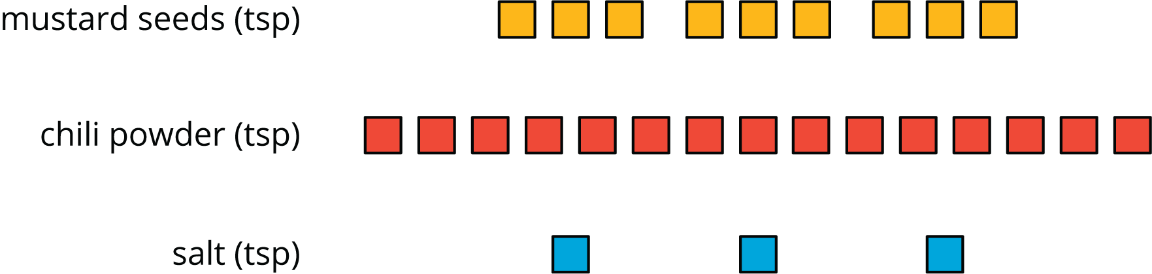
5.1.5 Collaboration: Interpreting Ratios With Diagrams
The diagram shows the ingredients Luca mixed to make the same spice mix recipe.
Work with your partner to determine how many batches of spice mix are represented by the diagram. Explain or show your reasoning.
volume 1, pg. 177

Slide 24
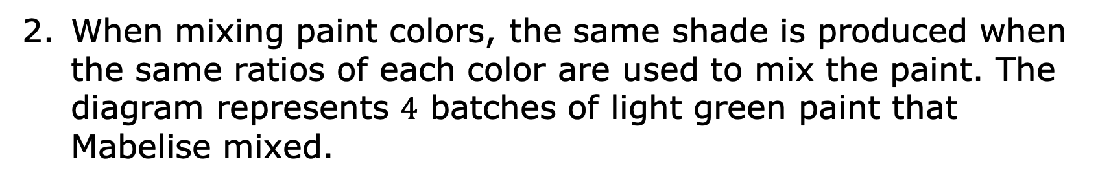
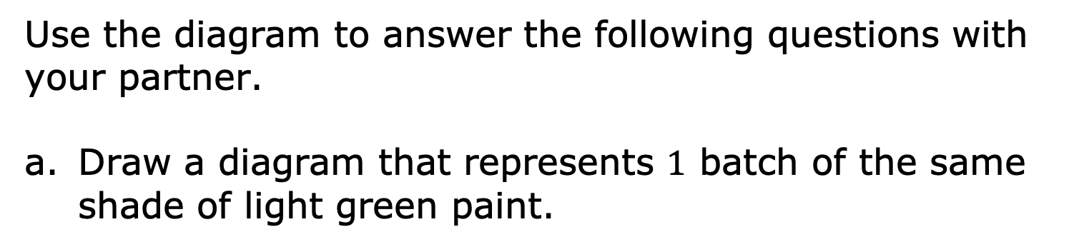
When mixing paint colors, the same shade is produced when the same ratios of each color are used to mix the paint. The diagram represents $4$ batches of light green paint that Mabelise mixed.
white paint (cups)
green paint (cups)
Use the diagram to answer the following questions with your partner.
Draw a diagram that represents $1$ batch of the same shade of light green paint.
volume 1, pg. 177

Slide 25
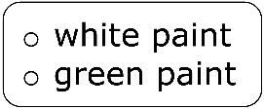
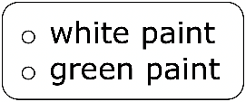
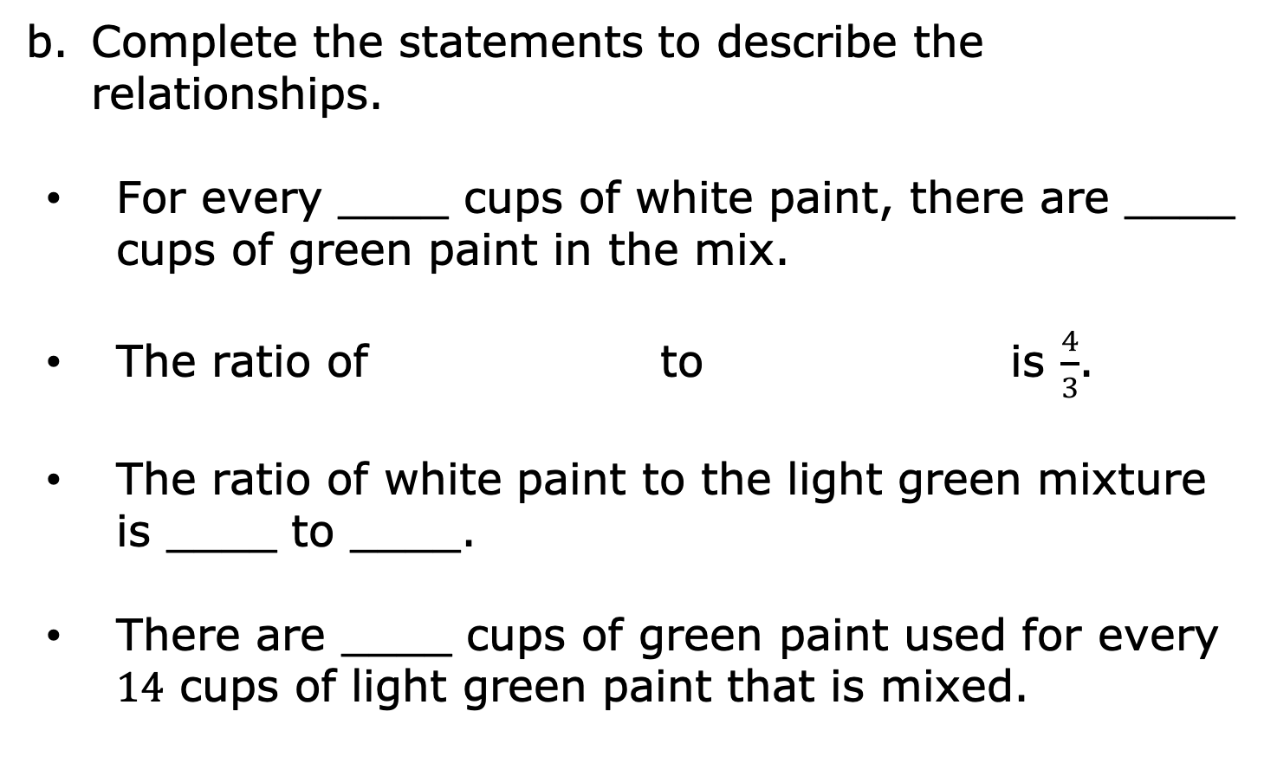
Complete the statements to describe the relationships.
For every ____ cups of white paint, there are ____ cups of green paint in the mix.
The ratio of to is $\frac{4}{3}$.
The ratio of white paint to the light green mixture is ____ to ____.
There are ____ cups of green paint used for every $14$ cups of light green paint that is mixed.
volume 1, pg. 177

Slide 26

Wrap-Up
volume 1, pg. 178

Slide 27
5.1.6 Wrap-Up: Reflection
Draw an X on each line to indicate where your current level of understanding is related to each target.
I can write and interpret ratios.
I need help. I can’t get started. | I’m getting there, but I need more practice. | I understand this, and I feel confident.
I can draw a diagram that represents a ratio and explain what a diagram means.
I need help. I can’t get started. | I’m getting there, but I need more practice. | I understand this, and I feel confident.
volume 1, pg. 178

